Slide 1

MASTER THE TIDYVERSE
Mike K Smith
Winter 2020
Materials used in this course are derived from
https://github.com/rstudio-education/master-the-tidyverse/
and are shared under a CC-BY-SA-4.0 license.

Slide 2


HELLO
my name is
Mike
 @MikeKSmith
MikeKSmith
Mike.K.Smith@Pfizer.com
CC BY-SA RStudio
Notes:
* introduce yourself

Slide 3

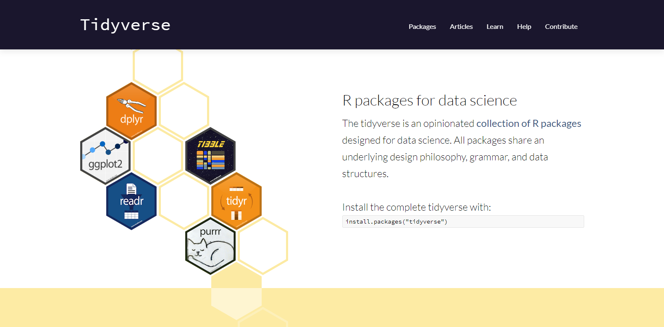
http://tidyverse.org
https://r4ds.had.co.nz/
CC BY-SA RStudio

Slide 4
Introduction and Visualize Data | 17th Jan
Transforming (subsetting) data | 24th Jan
Importing and reshaping data | 31st Jan
Data Types: strings, factors, date-times | 7th Feb
Iteration & Modelling | 14th Feb
Reproducible reporting | 21st Feb
CC BY-SA RStudio

Slide 6
Open 04-Import-Data.Rmd

Slide 7

(Applied) Data Science
Visualize
Import
Tidy
Model
Communicate
Transform
Program
CC BY-SA RStudio

Slide 8

Importing Data

Slide 9

readr
Simple, consistent functions for working with strings.
# install.packages("tidyverse")
library(tidyverse)
CC BY-SA RStudio

Slide 10
Compared to read.table and its derivatives, readr functions are:
~ 10 times faster
Return tibbles
Have more intuitive defaults. No row names, no strings as factors.
CC BY-SA RStudio

Slide 11
readr functions
function | reads
read_csv() | Comma separated values
read_csv2() | Semi-colon separated values
read_delim() | General delimited files
read_fwf() | Fixed width files
read_log() | Apache log files
read_table() | Space separated
read_tsv() | Tab delimited values
CC BY-SA RStudio

Slide 12
readr functions
function | reads
read_csv() | Comma separated values
read_csv2() | Semi-colon separated values
read_delim() | General delimited files
read_fwf() | Fixed width files
read_log() | Apache log files
read_table() | Space separated
read_tsv() | Tab delimited values
CC BY-SA RStudio

Slide 13
Chapter15_example2.csv
PATIENT,HAMATOTL,PGIIMP,RELDAYS,VISIT,THERAPY,GENDER,POOLINV,basval,HAMDTL17,change
1503,21,2,7,4,DRUG,F,6,32,21,-11
1503,19,2,14,5,DRUG,F,6,32,20,-12
1503,21,3,28,6,DRUG,F,6,32,19,-13
1503,17,4,42,7,DRUG,F,6,32,17,-15
1507,18,3,7,4,PLACEBO,F,6,14,11,-3
1507,18,2,15,5,PLACEBO,F,6,14,14,0
1507,14,3,29,6,PLACEBO,F,6,14,9,-5
1507,8,2,42,7,PLACEBO,F,6,14,5,-9
1509,18,3,7,4,DRUG,F,6,21,20,-1
CC BY-SA RStudio

Slide 14
Chapter15_example2.csv
PATIENT,HAMATOTL,PGIIMP,RELDAYS,VISIT,THERAPY,GENDER,POOLINV,basval,HAMDTL17,change
1503,21,2,7,4,DRUG,F,6,32,21,-11
1503,19,2,14,5,DRUG,F,6,32,20,-12
1503,21,3,28,6,DRUG,F,6,32,19,-13
1503,17,4,42,7,DRUG,F,6,32,17,-15
1507,18,3,7,4,PLACEBO,F,6,14,11,-3
1507,18,2,15,5,PLACEBO,F,6,14,14,0
1507,14,3,29,6,PLACEBO,F,6,14,9,-5
1507,8,2,42,7,PLACEBO,F,6,14,5,-9
1509,18,3,7,4,DRUG,F,6,21,20,-1
CC BY-SA RStudio

Slide 15
read_csv()
readr functions share a common syntax
df <- read_csv("path/to/file.csv", …)
object to save output into
path from working directory to file
CC BY-SA RStudio

Slide 16

Your Turn 1
Find chapter15_example2.csv on your server or computer. Then read it into an object. Then view the results.

Slide 17
Your Turn 1
Find chapter15_example2.csv on your server or computer. Then read it into an object. Then view the results.
depression <- read_csv("chapter15_example2.csv")
depression

Slide 18
Parsing

Slide 19
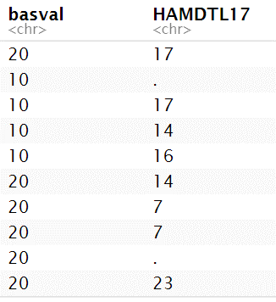
. = NA
depression
CC BY-SA RStudio

Slide 20
read_csv()
readr functions share a common syntax
depression <- read_csv("chapter15_example2.csv", na = ".")
object to save output into
path from working directory to file
Value(s) to convert to NA
CC BY-SA RStudio

Slide 21
Your Turn
Reread in chapter15_example2.csv. But this time convert the "."’s to NA’s. How many NA’s are in the HAMDTL17 column?

Slide 22
Your Turn
Reread in chapter15_example2.csv. But this time convert the "."’s to NA’s. How many NA’s are in the ozone column?
depression <- read_csv("chapter15_example2.csv", na = ".")
View(depression)
depression %>%
summarize(nas = sum(is.na(HAMDTL17)), n = n())
## # A tibble: 1 × 2
## nas n
## <int> <int>
## 1 10 608

Slide 23
Quiz
What "type" of column is PGIIMP?

Slide 24
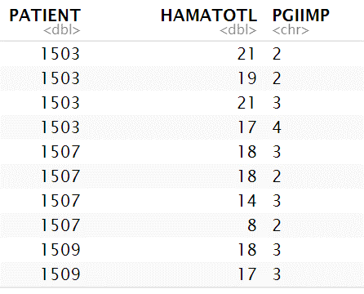
depression <- read_csv("chapter15_example2.csv", na = ".")
<chr> stands for character string
(not a number)
CC BY-SA RStudio

Slide 25
read_csv()
readr functions share a common syntax
depression <- read_csv("chapter15_example2.csv", na = "."),
col_types = list(PGIIMP = col_integer()))
Manually specify column types.
list
column name
Column type
function
CC BY-SA RStudio

Slide 26
type function | data type
col_character() | character
col_date() | Date
col_datetime() | POSIXct (date-time)
col_double() | double (numeric)
col_factor() | factor
col_guess() | let readr guess (default)
col_integer() | integer
col_logical() | logical
col_number() | numbers mixed with non-number characters
col_numeric() | double or integer
col_skip() | do not read
col_time() | time
CC BY-SA RStudio

Slide 27
type function | data type
col_character() | character
col_date() | Date
col_datetime() | POSIXct (date-time)
col_double() | double (numeric)
col_factor() | factor
col_guess() | let readr guess (default)
col_integer() | integer
col_logical() | logical
col_number() | numbers mixed with non-number characters
col_numeric() | double or integer
col_skip() | do not read
col_time() | time
CC BY-SA RStudio

Slide 28

Your Turn
Read in chapter15_example2.csv. accounting for NA’s and setting the col_type of PGIIMP to an integer. Plot HAMDTL17 and/or PGIIMP across time, showing individual patient profiles (spaghetti plot)
depression %>%
ggplot(mapping = aes(x = RELDAYS, y = PGIIMP,
group = PATIENT)) +
geom_line(alpha=0.2)
depression %>%
ggplot(mapping = aes(x = RELDAYS, y = HAMDTL17,
group = PATIENT)) +
geom_line(alpha=0.2)

Slide 29
depression <- read_csv("chapter15_example2.csv",
na = c(".", "NA"),
col_types = list(PGIIMP = col_integer()))
depression %>%
ggplot(mapping = aes(x = RELDAYS, y = HAMDTL17,
group = PATIENT)) +
geom_line(alpha=0.2)
CC BY-SA RStudio

Slide 30
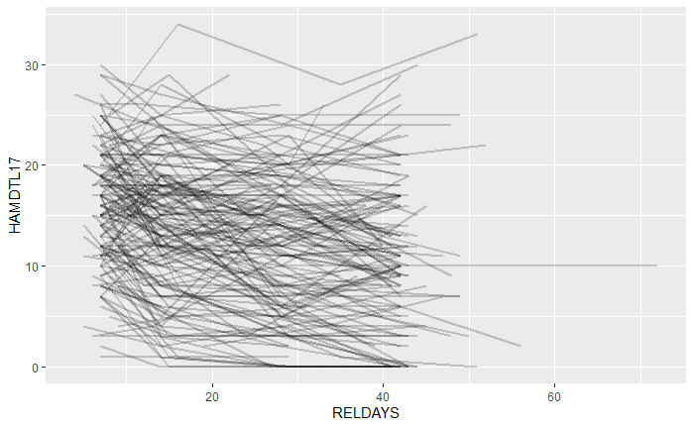
CC BY-SA RStudio

Slide 31
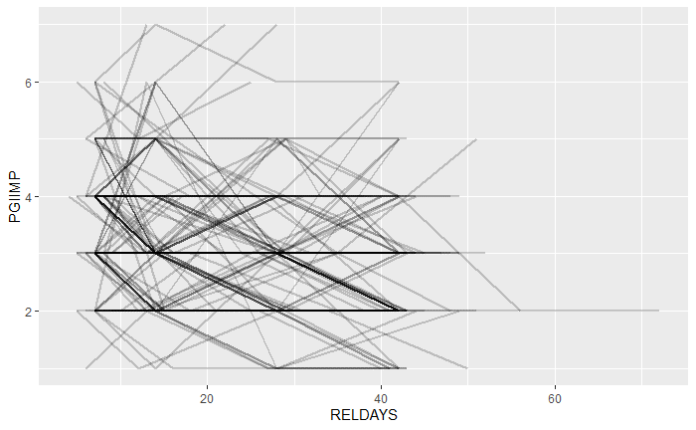
CC BY-SA RStudio

Slide 32
Writing

Slide 33
readr functions
function | writes
write_csv() | Comma separated values
write_excel_csv() | CSV intended for opening in Excel
write_delim() | General delimited files
write_file() | Single string, written as is
write_lines() | Vector of strings, one element per line
write_tsv() | Tab delimited values
CC BY-SA RStudio

Slide 34
write_csv()
Saves data set as a csv on your computer.
write_csv(depression, file = "depression.csv")
Table to save
file
path to save at
CC BY-SA RStudio

Slide 35
Other types of data
package | accesses
haven | SPSS, Stata, and SAS files
readxl | excel files (.xls, .xlsx)
openxlsx jsonlite | write excel files json
xml2 | xml
httr | web API’s
rvest | web pages (web scraping)
DBI | databases
sparklyr | data loaded into spark
CC BY-SA RStudio

